Slide 1
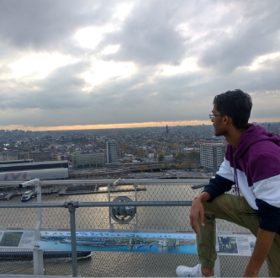
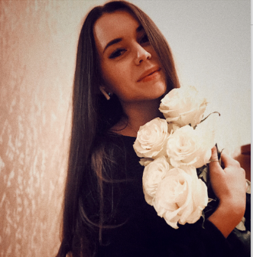
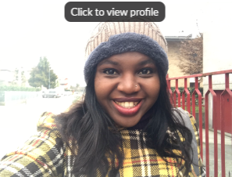
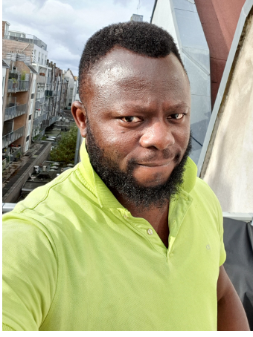
Build Week #1

Slide 2
Project description
The aim of the project is to build a Spotify clone. The Spotify clone consist of four pages which are Login page, Home page, Album page, Artist page. Because we are team of four we divided this project in four places respectively.

Slide 3
Project Aim
Develop a Spotify clone using bootstrap/Javascripts /CSS3
Make it responsive i.e mobile first
Work as a group using GitHub
Creating a live demo for tutor

Slide 4
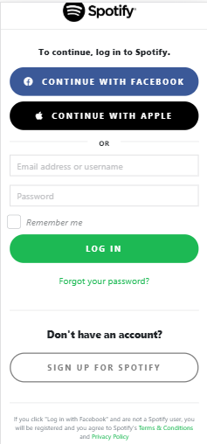
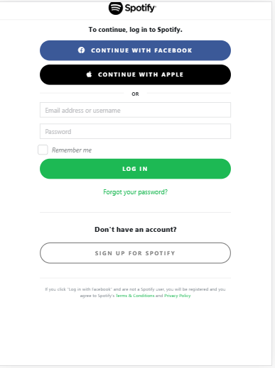
Login page

Slide 5
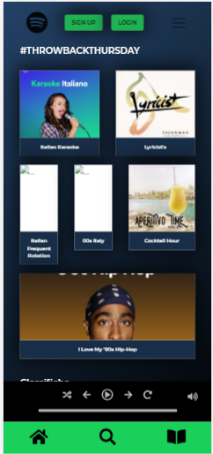
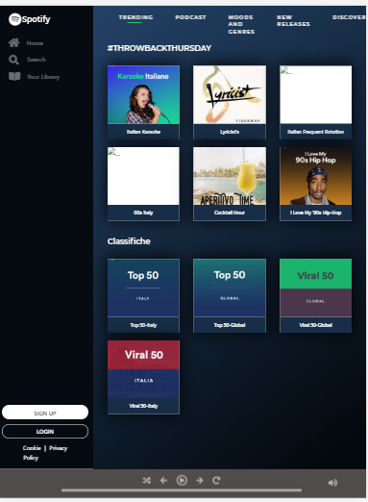
Home Page

Slide 6
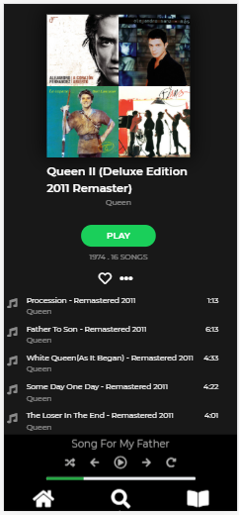
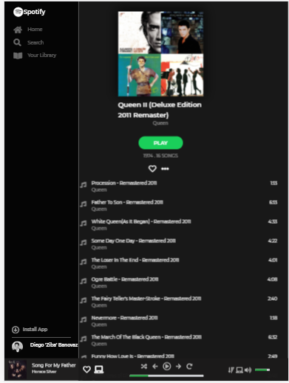
Album Page

Slide 7
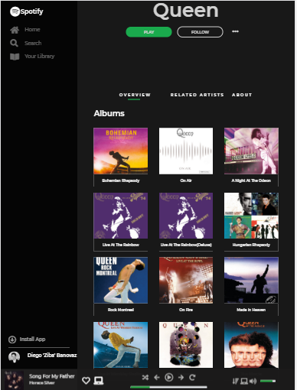
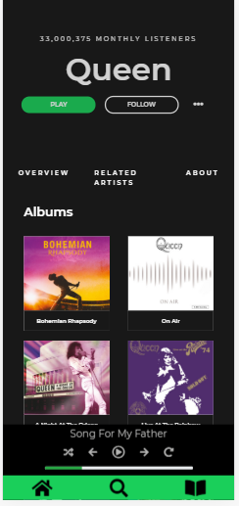
Artist Page

Slide 8
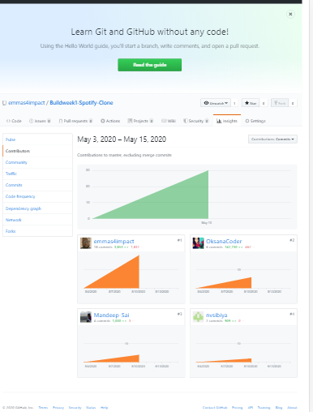
Collaborators

Slide 9
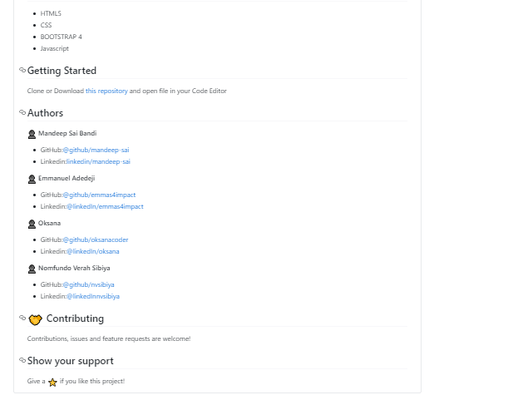
ReadMe

Slide 10
Gratitude
Special thanks goes the tutors
Stefano Casasola
Diego Banovaz
Stefano Miceli
And our team did great Job!
Mandeep
Oksana
Numfondo
Emmanuel

Slide 11
Thank you everyone and have a great weekend!

